Slide 1
Instructions
On each slide, guess the correct answer to the question.
If you are incorrect, click the “Try again” button to return to the previous slide.
If you are correct, spend time learning more about the Gift Catalog item. Then, click “Next” to continue!

Slide 2
YOU can make a difference!
Send Relief serves people all around the world because of friends like you. Each item in the Gift Catalog represents a way you can make a difference.
Can you guess how each gift helps people? Let’s learn together!

Slide 3
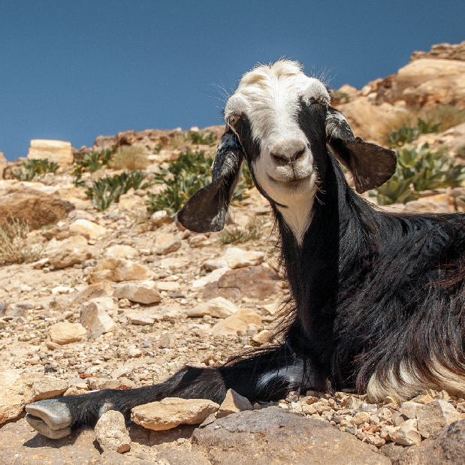
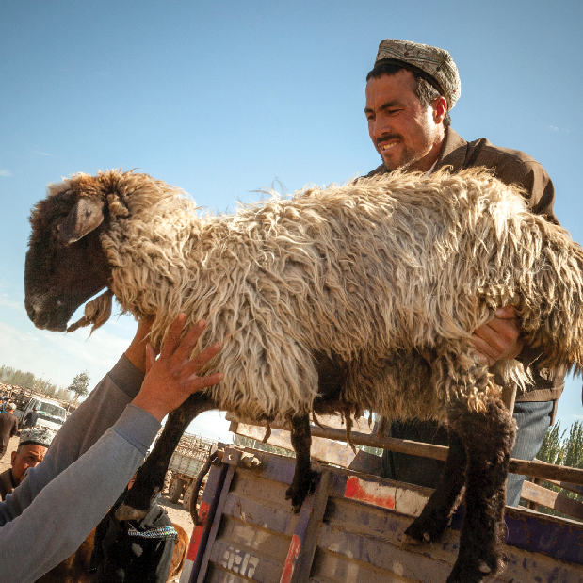
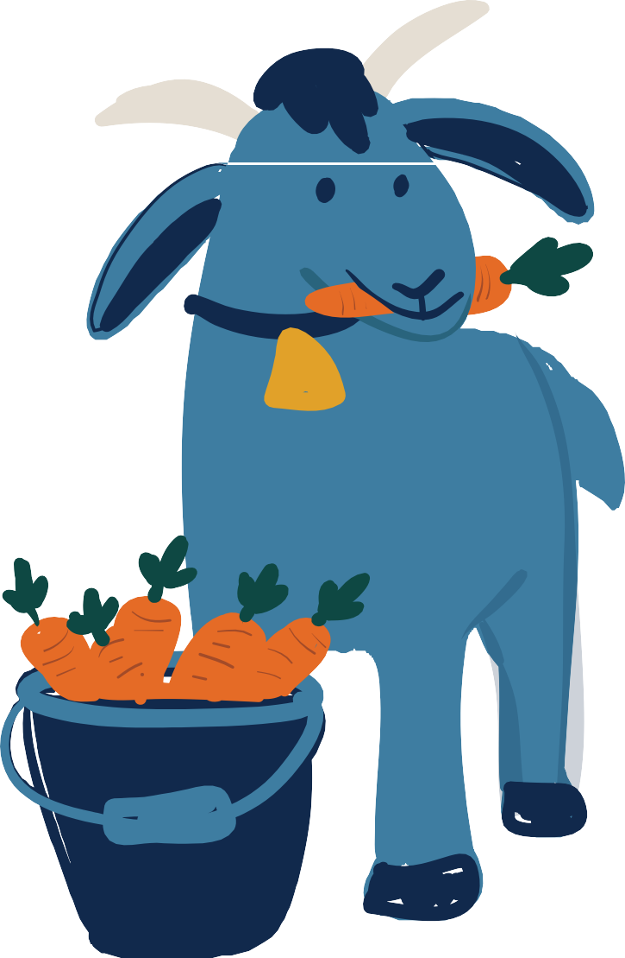
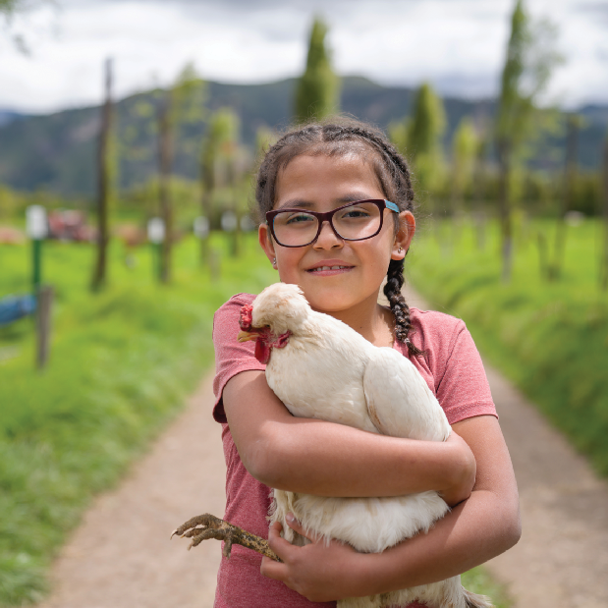
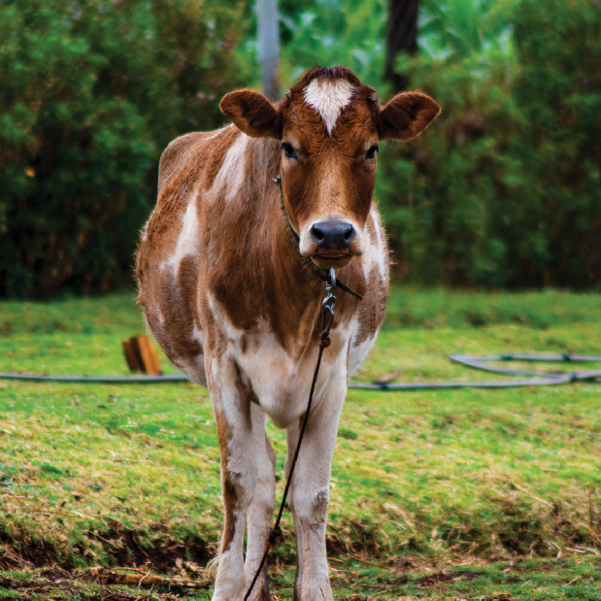
Which gift provides food for families by laying eggs?
GOATS
SHEEP
CHICKENS
COWS

Slide 4
Oops! That’s not correct.

Slide 5
Yes!
Chickens lay eggs that provide food for families. The eggs can even be sold for money at local markets!
For example, in sub-Saharan Africa, children with special needs are often ignored by their families and communities. Your gifts have provided a special needs school with chicks and feed for teachers to train their students in chicken farming and entrepreneurship. These children are now learning practical life skills and becoming productive, accepted members of their communities!
NEXT

Slide 6
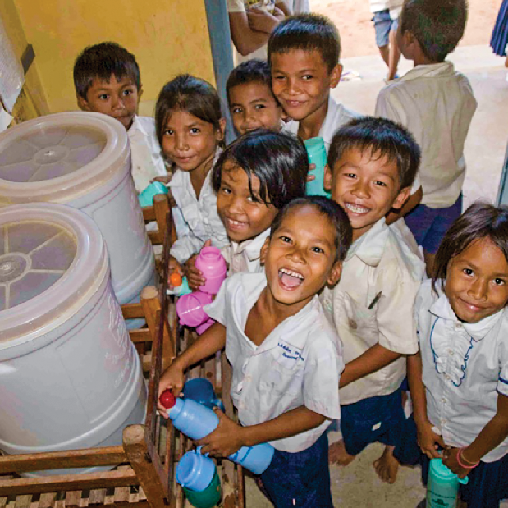
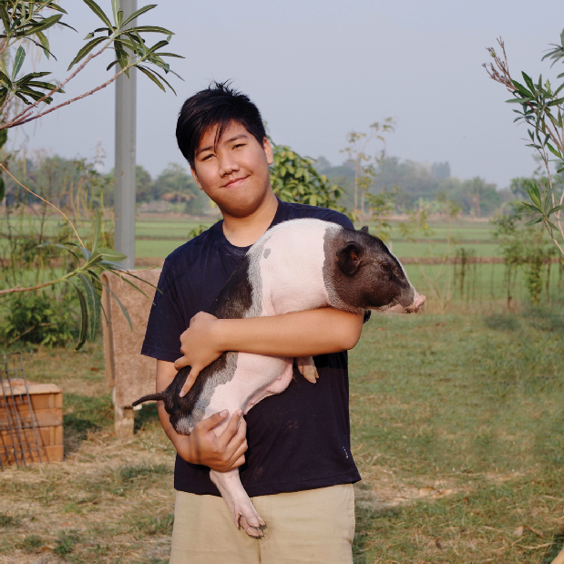
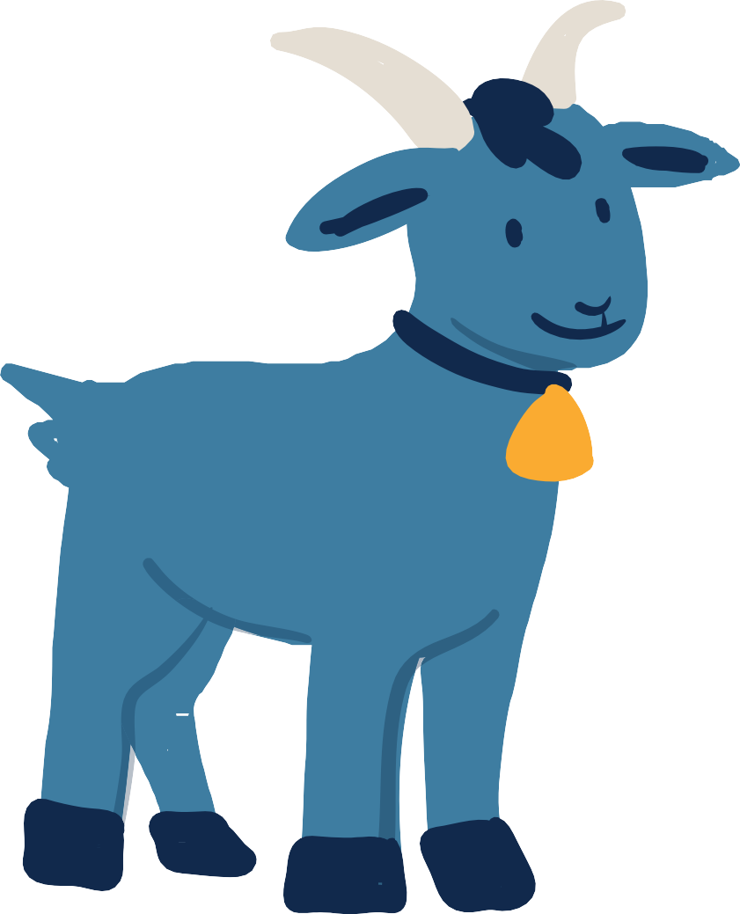
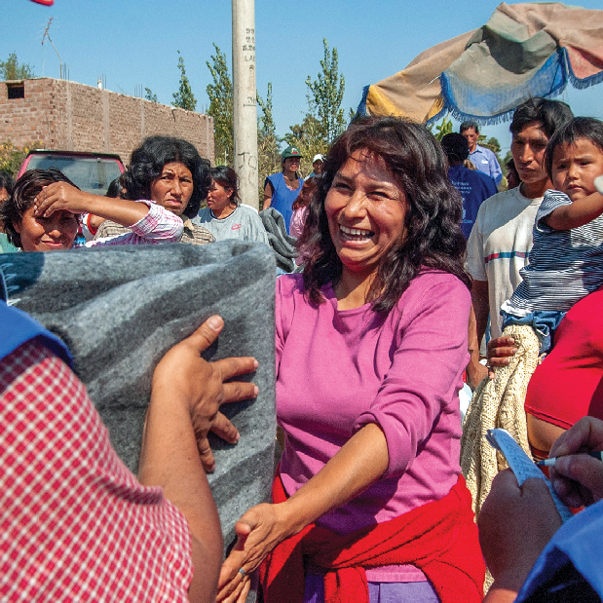
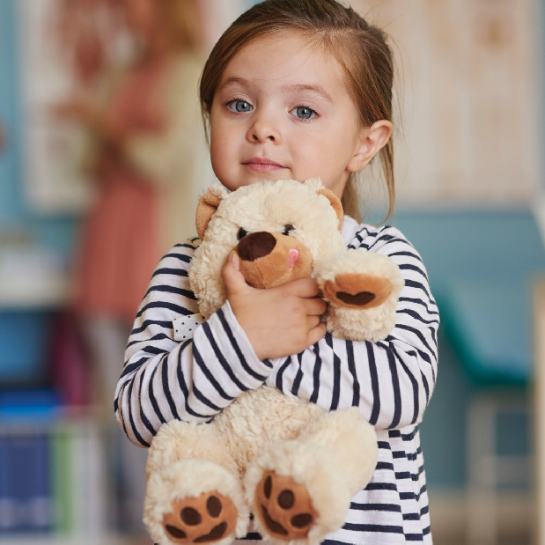
WATER FILTER
PIGS
Which gift removes bacteria and helps reduce diseases for children and families?
BLANKET
PAJAMAS

Slide 7
Oops! That’s not correct.

Slide 8
Yes!
A ceramic water filter is an inexpensive, safe way for families to guarantee that the water their children are drinking every day is not contaminated by bacteria or disease.
In Southeast Asia, Send Relief partners distributed water filters to over 1,000 people. Now, these families don’t have to worry about whether their water is clean—they can drink it right away! Send Relief partners also had the opportunity to talk to the people about Jesus, and many people decided to follow Him.
NEXT

Slide 9
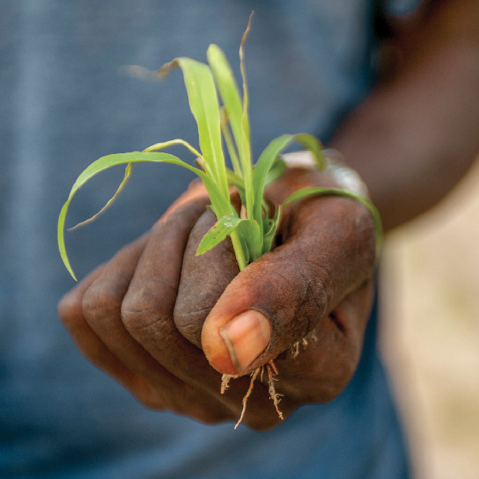
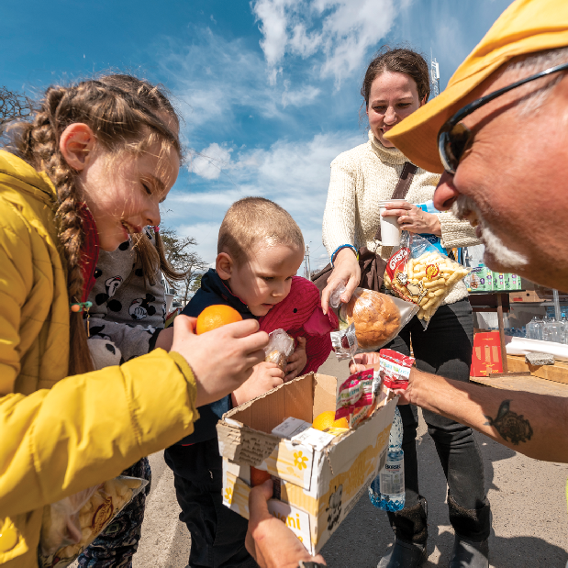
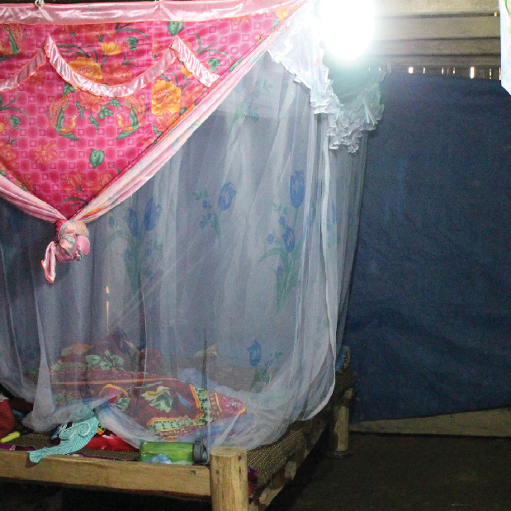
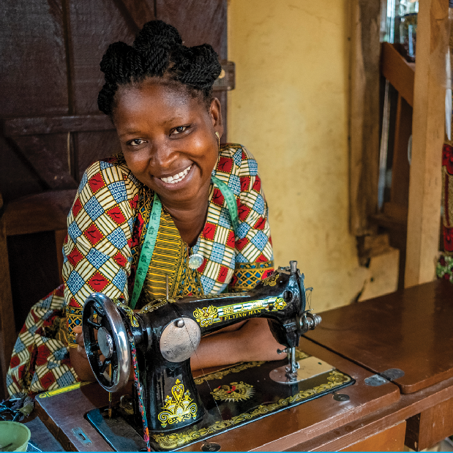
What gift can bring comfort to refugees as they enter a new town or country?
SEEDS
WELCOME BASKET
MOSQUITO NET
SEWING MACHINE

Slide 10
Oops! That’s not correct.

Slide 11
Yes!
You can make an incoming refugee family feel welcomed and loved by their new community with a basket full of food, school supplies, clothing, and more.
Refugees are people who have to leave their homes because of war or other tragedies. Many times, they arrive in new countries with very few belongings and are in need of food, language classes, and love.
Whether you provide a food box, a place to live, or a welcome basket,
you are sharing the love of Jesus with people who need it most!
NEXT

Slide 12
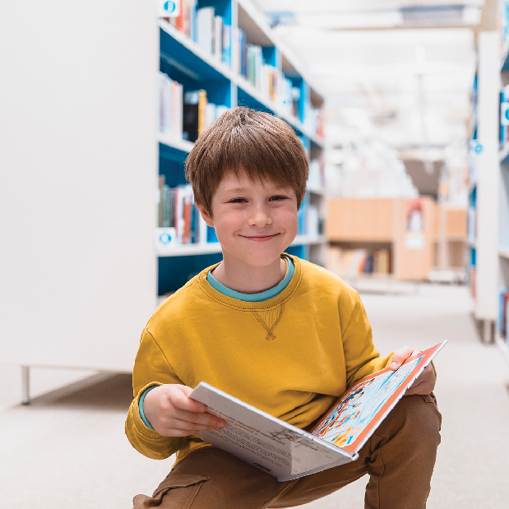
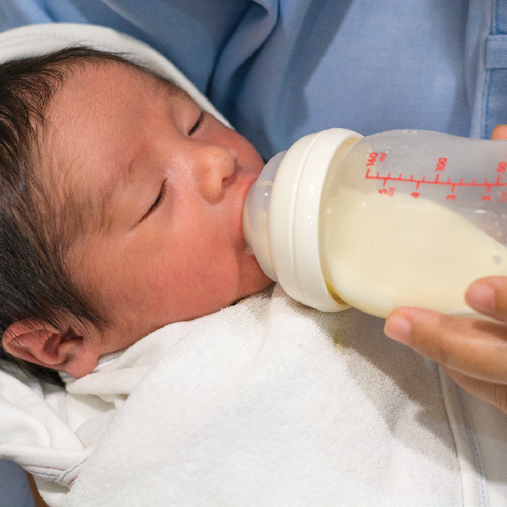
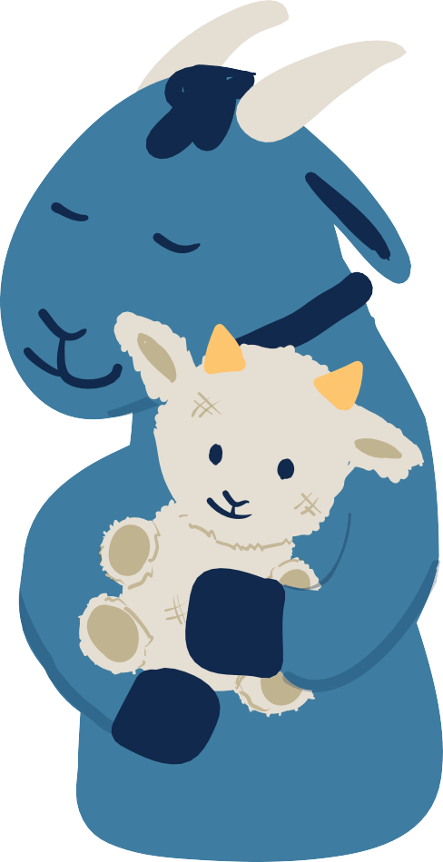
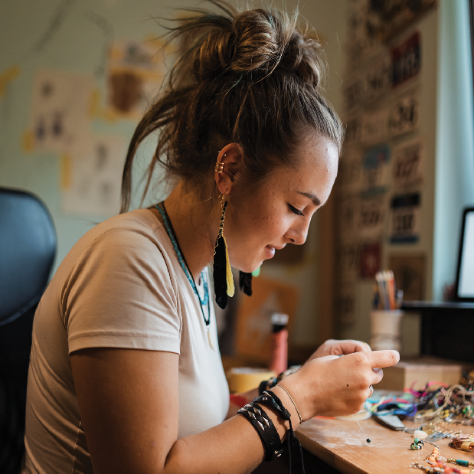
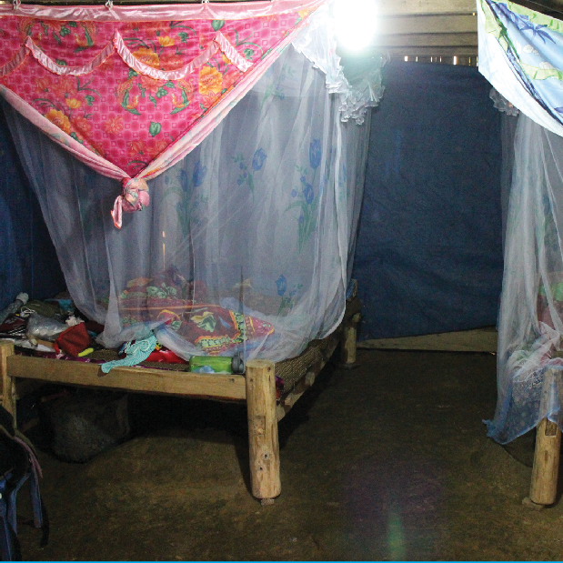
What gift protects children from bug bites while they sleep?
BOOKS
INFANT FORMULA
JOB SKILLS TRAINING
MOSQUITO NET

Slide 13
Oops! That’s not correct.

Slide 14
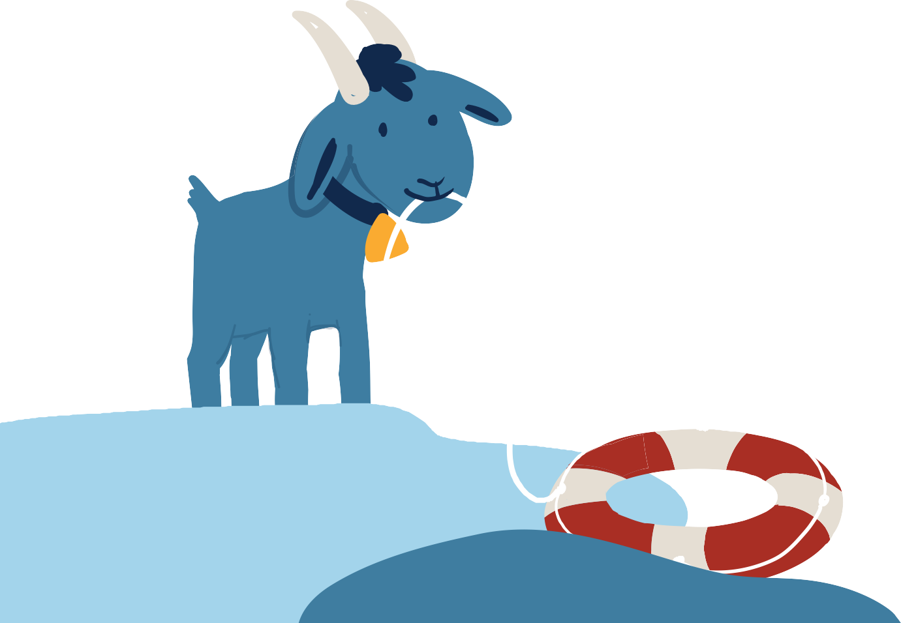
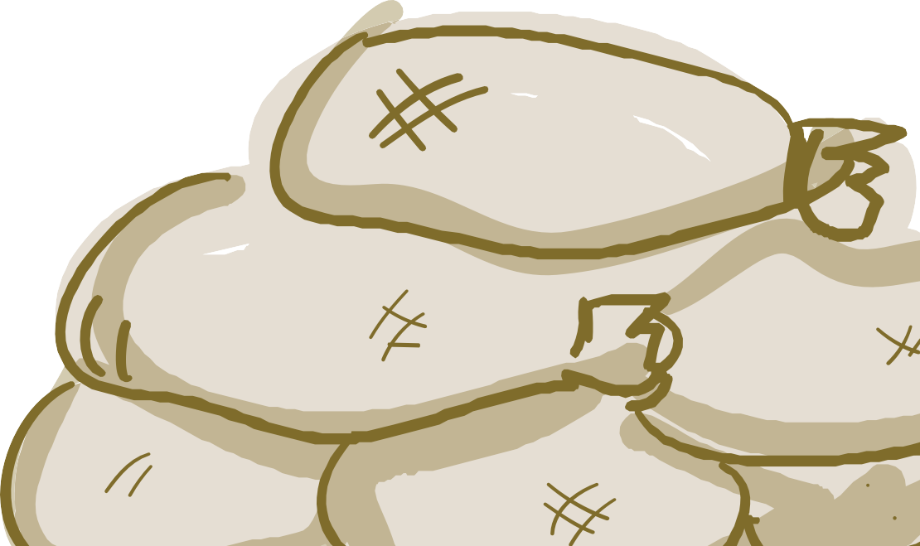
Yes!
In some countries around the world, insects can carry diseases. A mosquito net is a great way to protect children from those pesky bugs!
A Send Relief project provided mosquito nets to an estimated 3,000 people in Thailand. These are communities with few Christians.
Through this project, Send Relief built relationships with the village
leaders and villagers that made it possible to share the gospel with them. Twelve people have accepted Christ so far!
NEXT
14

Slide 15
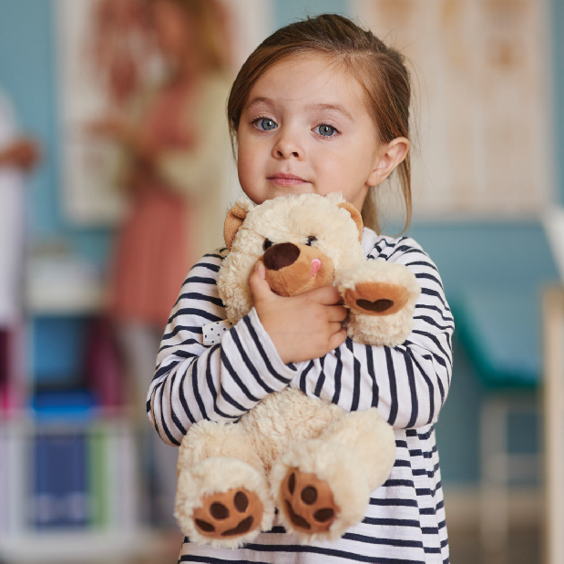
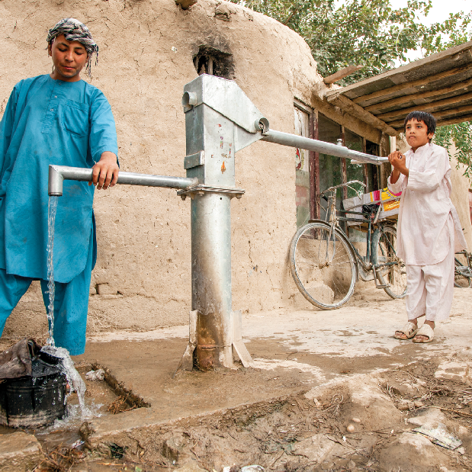
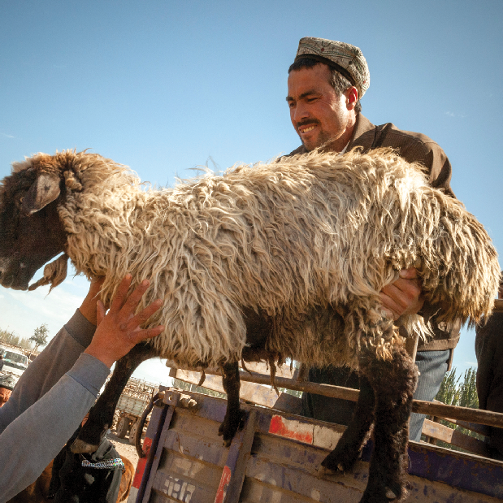
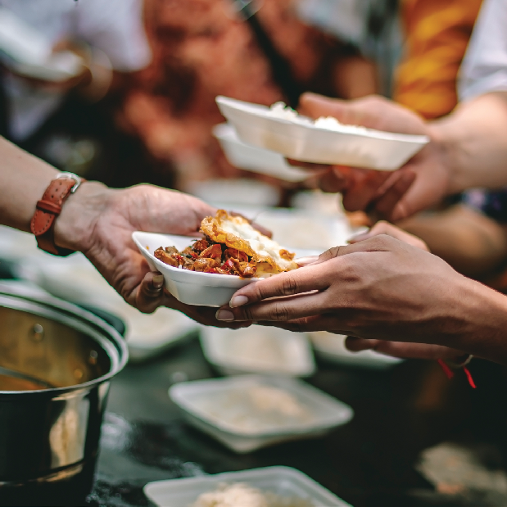
What gift can help comfort a child in foster care?
PAJAMAS AND A STUFFED ANIMAL
WATER WELL
SHEEP
FOOD SUPPLIES

Slide 16
Oops! That’s not correct.

Slide 17
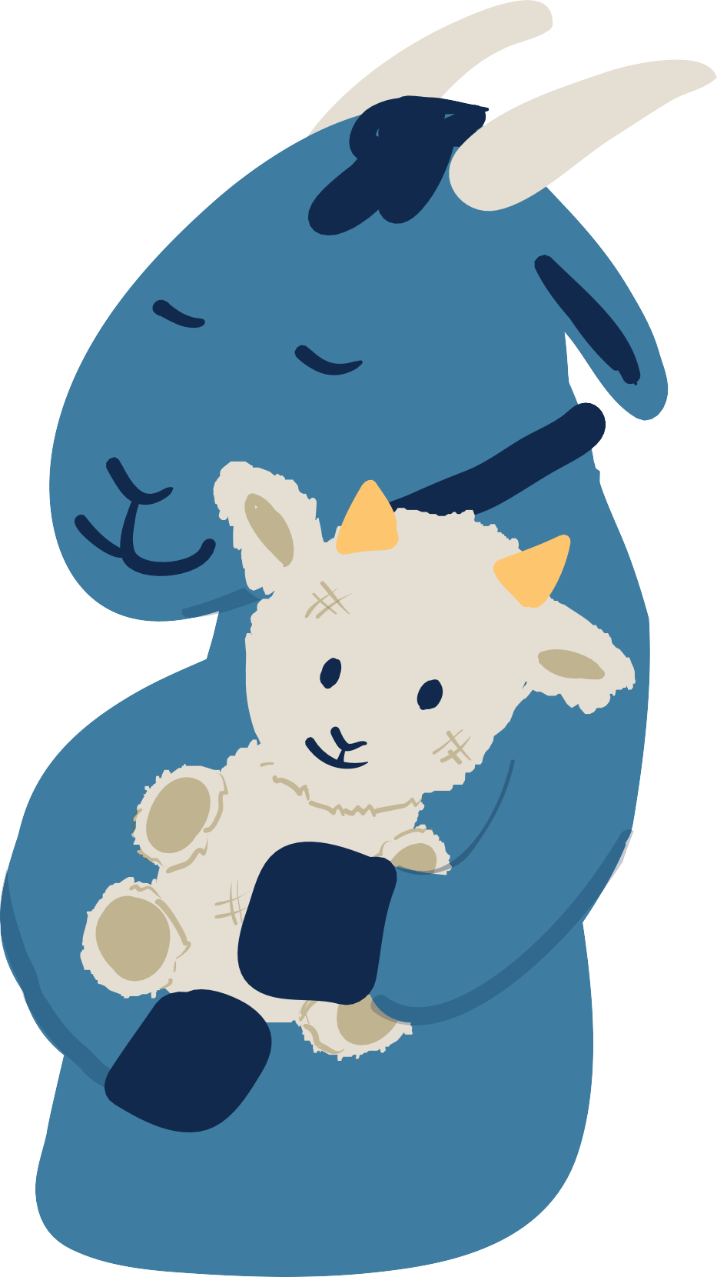
Yes!
When a child’s home is no longer safe for them, they are placed in foster care. Sometimes a child arrives without special comfort items like a stuffed animal.
Your gift of pajamas and a stuffed animal provide a moment of rest to a child in foster care. Through the Gift Catalog, you can also buy new clothes, books, and meals for children in need!

Slide 18
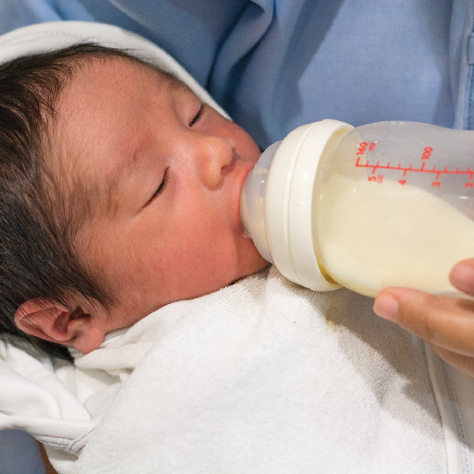
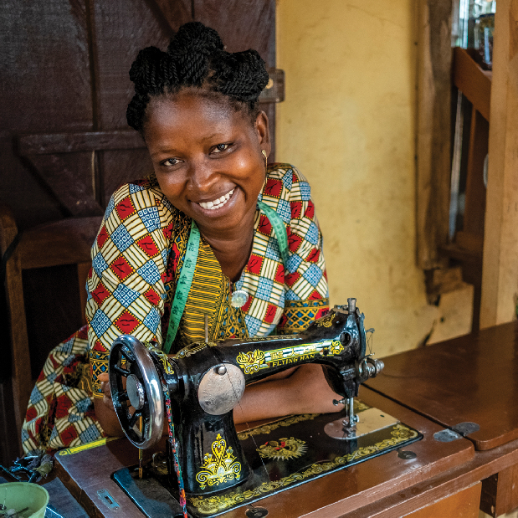
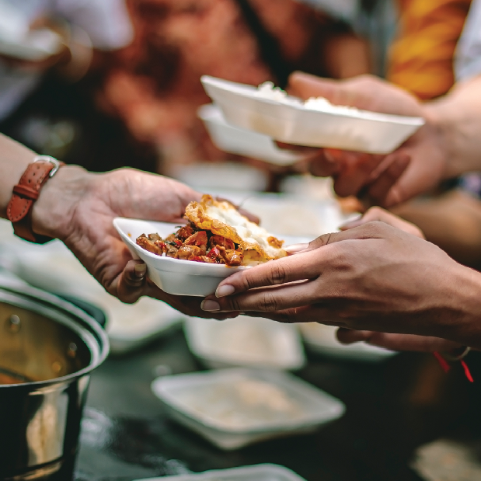
What gift can help someone start their own business?
INFANT FORMULA
SEWING MACHINE
BLANKET
MEALS

Slide 19
Oops! That’s not correct.

Slide 20
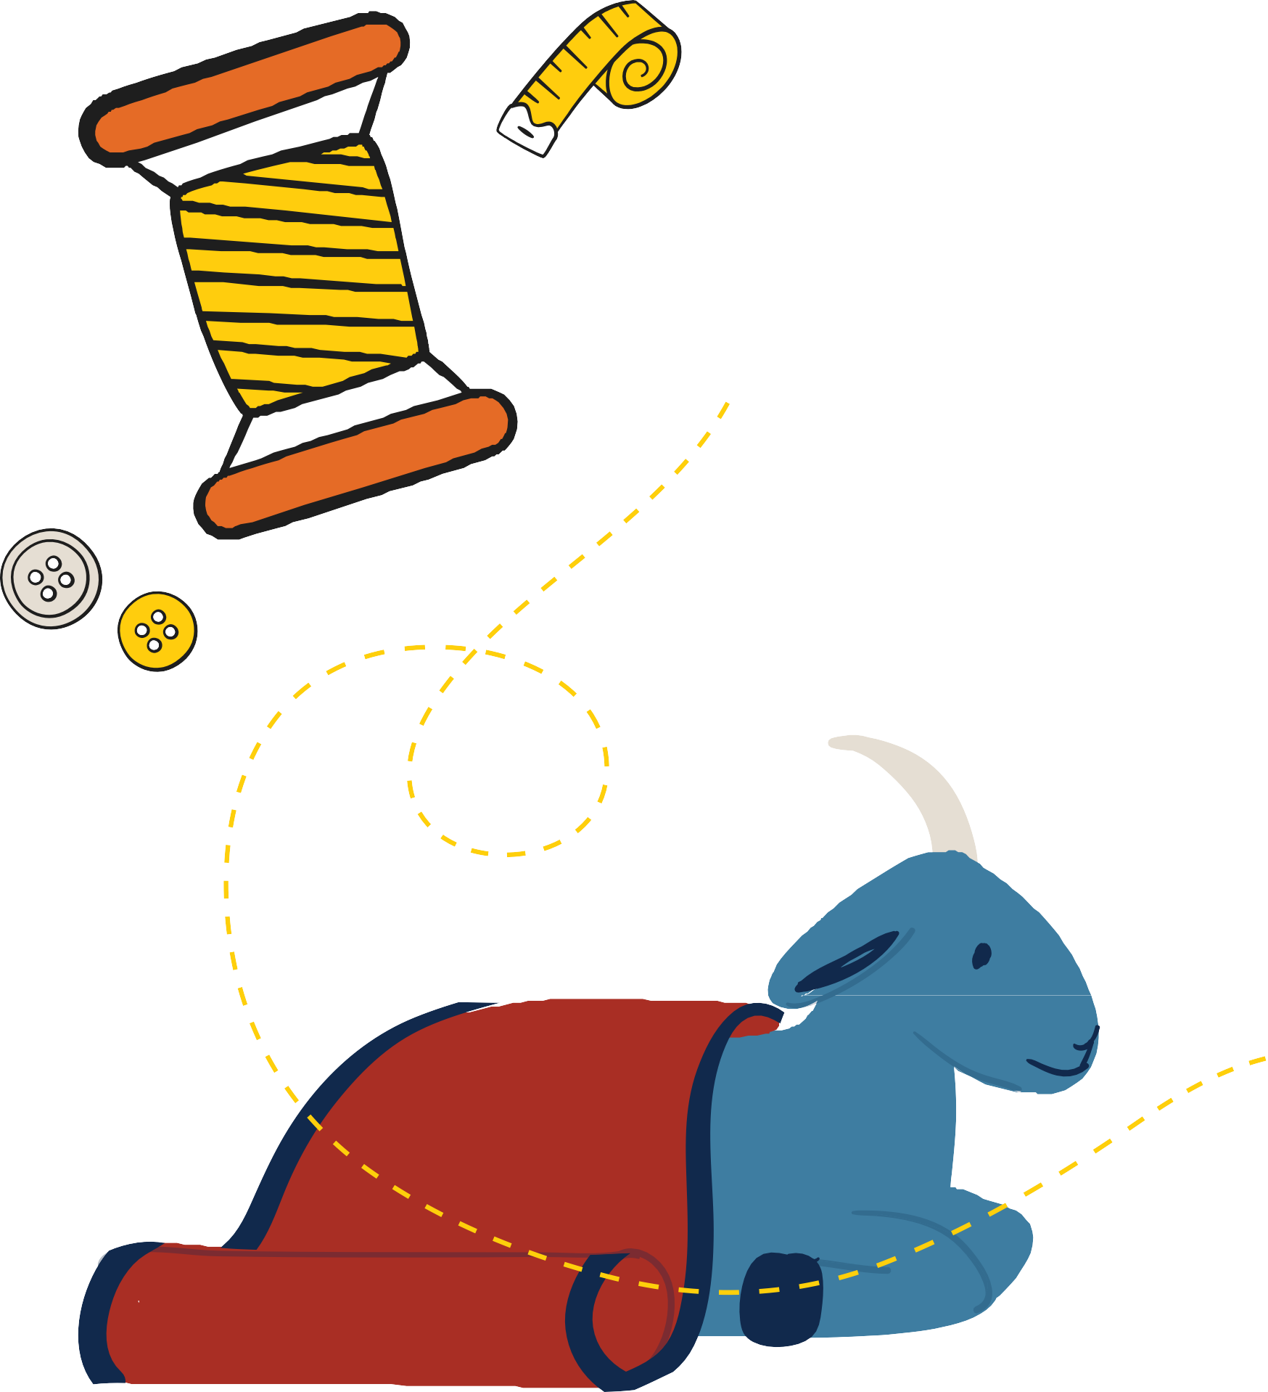
Yes!
Sewing machines are a creative way to start a clothes-making business. Your gift includes sewing classes and a sewing machine!
In South Africa, a sewing class brought together 60 women who are refugees from different backgrounds to learn a marketable skill so they can provide for their families. Not only did they learn to sew— they also studied the Bible together and built friendships. And seven women accepted Jesus as their Savior and Lord!
NEXT

Slide 21
You did it!
Together, we learned different ways to help people in need all around the world. Now it’s time to put your new knowledge to work. Can you raise money to buy your favorite item from the Gift Catalog?
To learn more about ways to make a difference, visit SendRelief.org.

