Slide 1


Slide 2
Leading a Life-Transforming Culture of Prayer
Daniel Henderson
64fellowship.com
DanielHenderson.org

Slide 3


Slide 4
Prayer Culture Immersion Experience with the 6:4 Fellowship
Who: Seminarians and church planters
When: May 4-6, 2026
Where: BRAVE Church, Englewood CO
Highlights: Learn and be equipped to lead a culture of prayer from Daniel Henderson, Strategic Renewal Staff, Jeff Schwartzentraub (host church Pastor), and others!
Cost: Free, thanks to generous donors

Slide 6
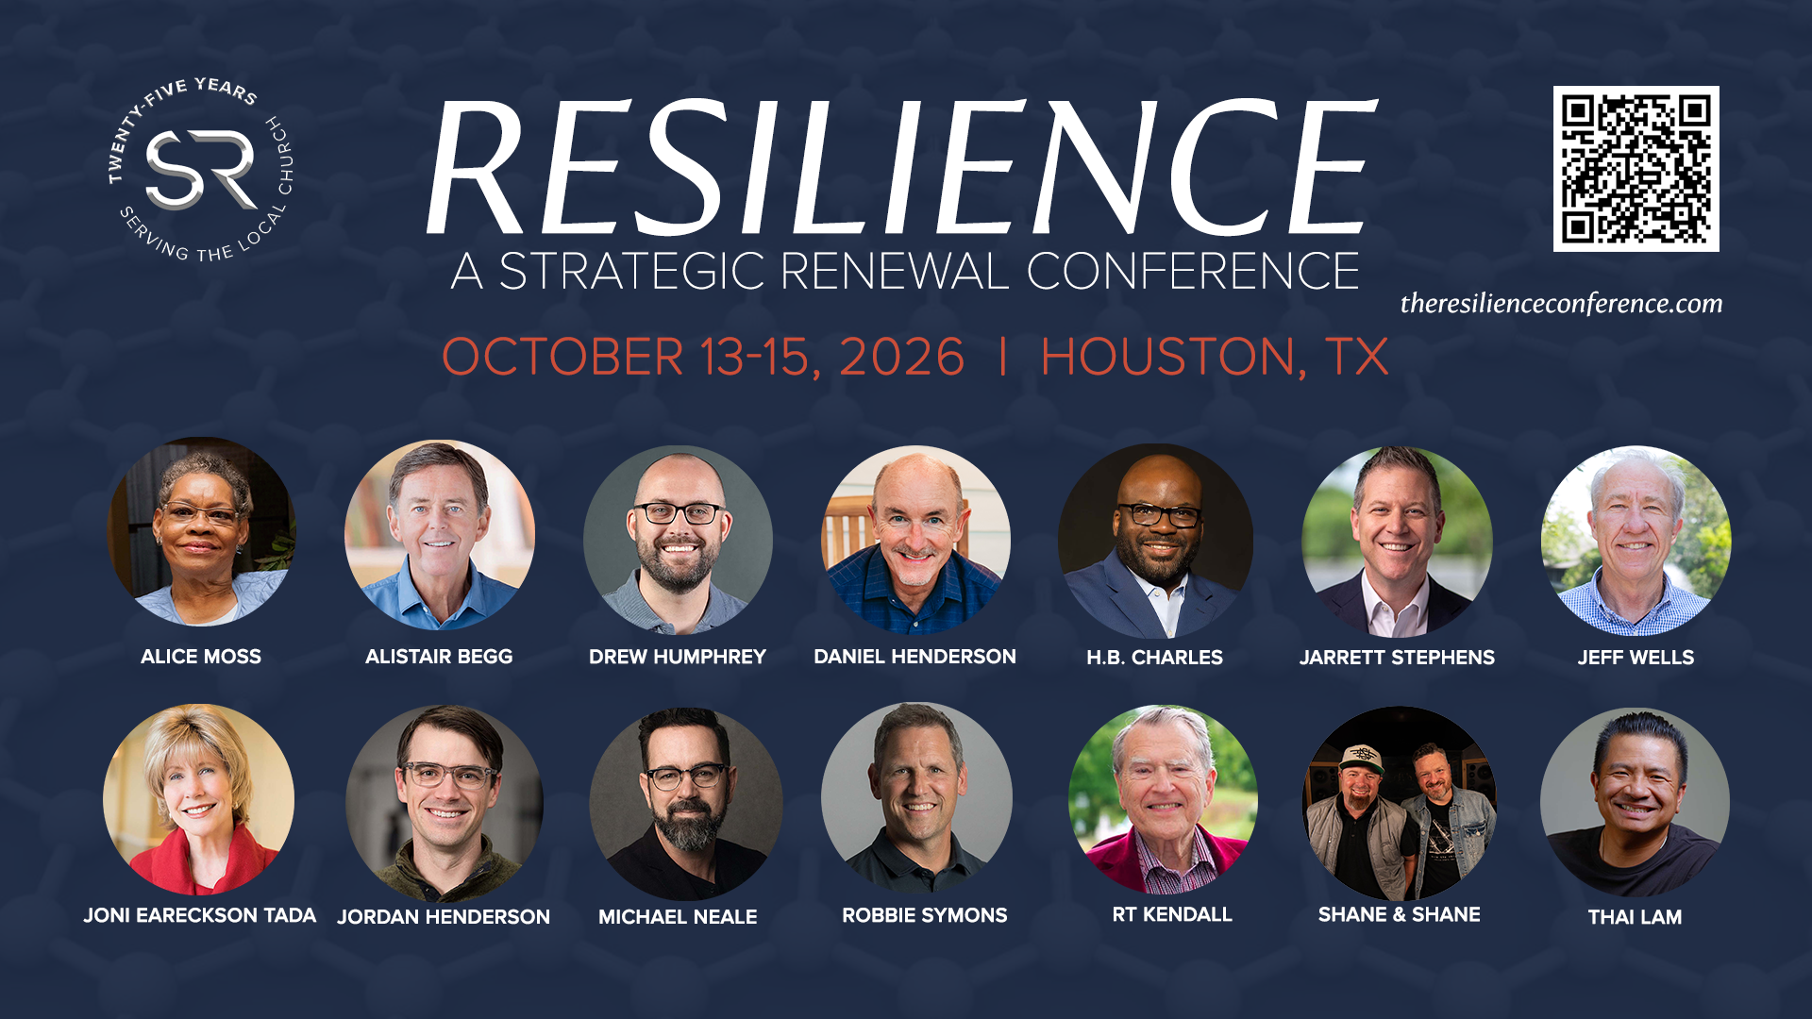

Slide 7


Slide 8
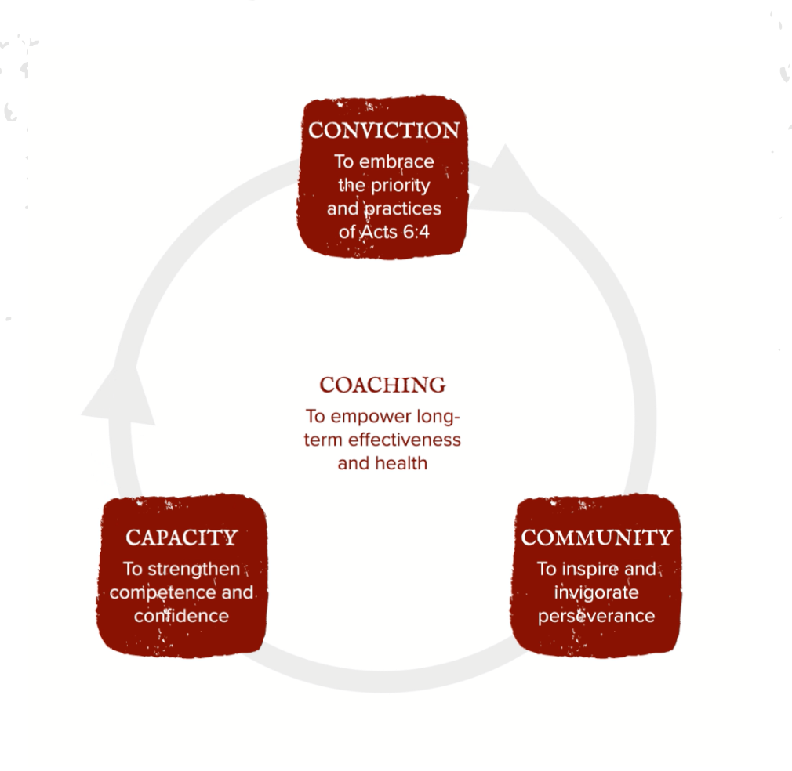

Slide 9
1. The foundation of CONVICTION (to embrace the priority and practices of Acts 6:4)
The priorities of an effective ministry
The patterns of your core team

Slide 10
Embrace the corporate nature of prayer
2. The focus on COMMUNITY
(to inspire and invigorate perseverance)
Build sidewalks on the footpaths

Slide 11
3. The formation of CAPACITY
(to strengthen and competence and confidence)
Experience the original prayer plan

Slide 12


The 2/2 Pattern for Prayer
He is
worthy!
We are
needy!

Slide 13
The 4/4 Pattern for Prayer
Upward
Reverence
Inward
Requests
Outward
Readiness
Downward
Response

Slide 14
3. The formation of CAPACITY (to strengthen and competence and confidence)
Experience the original prayer plan
Equip for exponential culture expansion

Slide 15
4. The fruit of COACHING
( to empower long-term effectiveness and health)
www.prayingleader.com

Slide 16
Cam Atha Video –
https://vimeo.com/1169609548/dc7274d068?share=copy&fl=sv&fe=ci

Slide 17
Scripture-fed,
Spirit-led,
worship-based prayer

